Slide 1
City Budget - Team A
Team Members: Toby Ueno, Deep Patel, Lucia Kisova, Thian Amarasekera

Slide 2
Project Overview
Project Sponsor: City of Boston
Project Motivation: The City of Boston determines a total every year for the operating budget and capital budget
Project Goal: Conduct analysis on how the budget is spread across different departments, neighborhoods and identify trends among the funded projects
Background: Familiarity with city budget visualizations, guide to the budget to get a sense on important terminology and definitions and look at state and local expenditures

Slide 3
Extension Project
Extension Pitch: Analyze Boston neighborhood spending per capita to inform equitable urban planning and development strategies for local policymakers and businesses
Data: Subset of 2020 Census data from the City of Boston website analyzed, containing population statistics by neighborhood, race/ethnicity, age, and miscellaneous information. Data cleaning involved renaming columns, converting data types, and organizing rows and columns for meaningful analysis.
Analysis: Explore spending patterns in neighborhoods with higher per capita expenditure, investigating proximity and population density influences.
Aim: The extension aims to validate hypotheses, providing insights into spatial and demographic dynamics affecting neighborhood spending
Findings will inform targeted interventions, enhancing understanding of economic dynamics at the community level in Boston

Slide 4
Extension Project - Progress
Early Observations: Population distribution varies significantly among neighborhoods and demographic characteristics may indicate a negative relationship for race and age.
Data Visualization: Create an informational heatmap of Boston displaying spending per capita in each respective neighborhood, offering a visually compelling tool for policymakers to make informed decisions on development and resource allocation regarding funding.

Slide 5
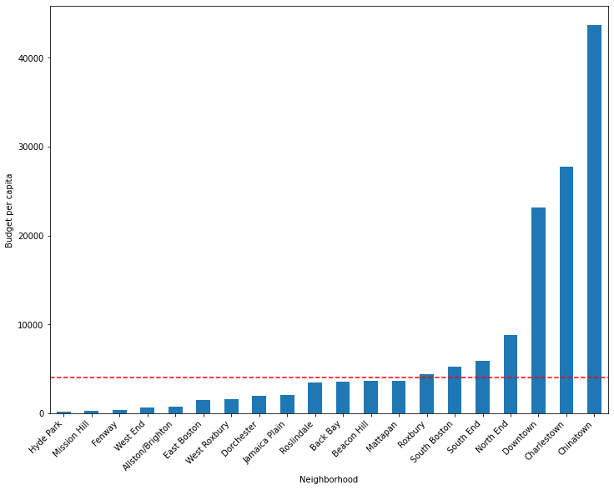
Extension Project - Visuals
Neighborhoods’ project budget allotment per-capita. Mean budget-per-capita across all neighborhoods displayed in red. Chinatown received the most project investment per-capita; Hyde Park received the least.

Slide 6
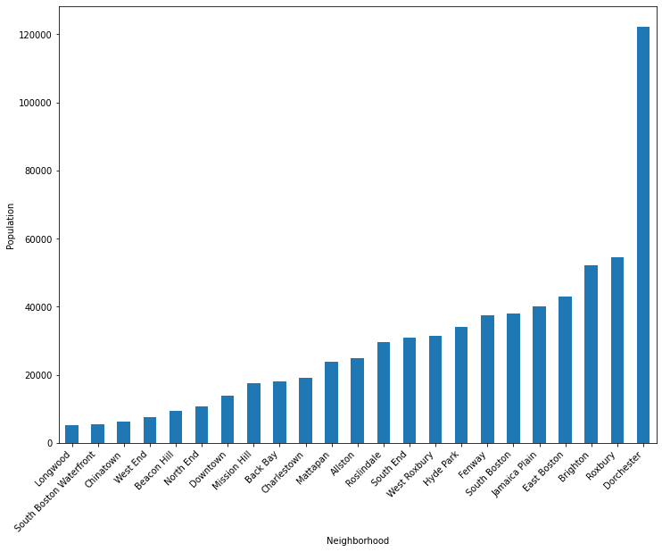
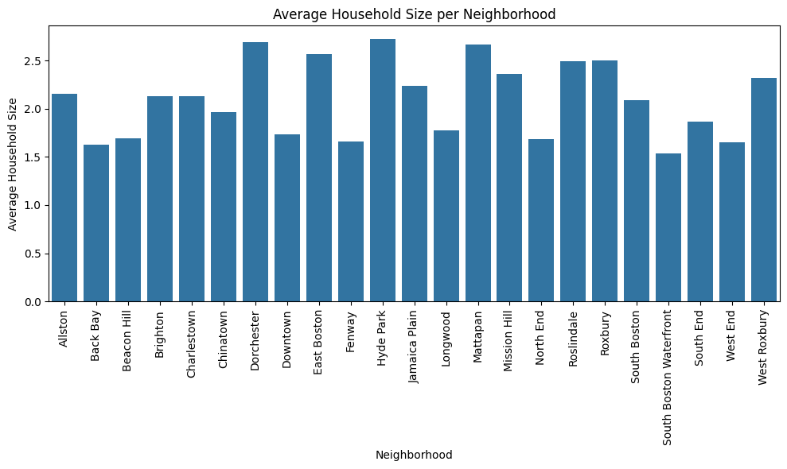
Extension Project - Visuals
Dorchester had highest population (double of second place Roxbury) with Longwood having the smallest population
Range of average household size by neighborhood was from 1.53 (South Boston Waterfront to 2.72 (Hyde Park)

Slide 7
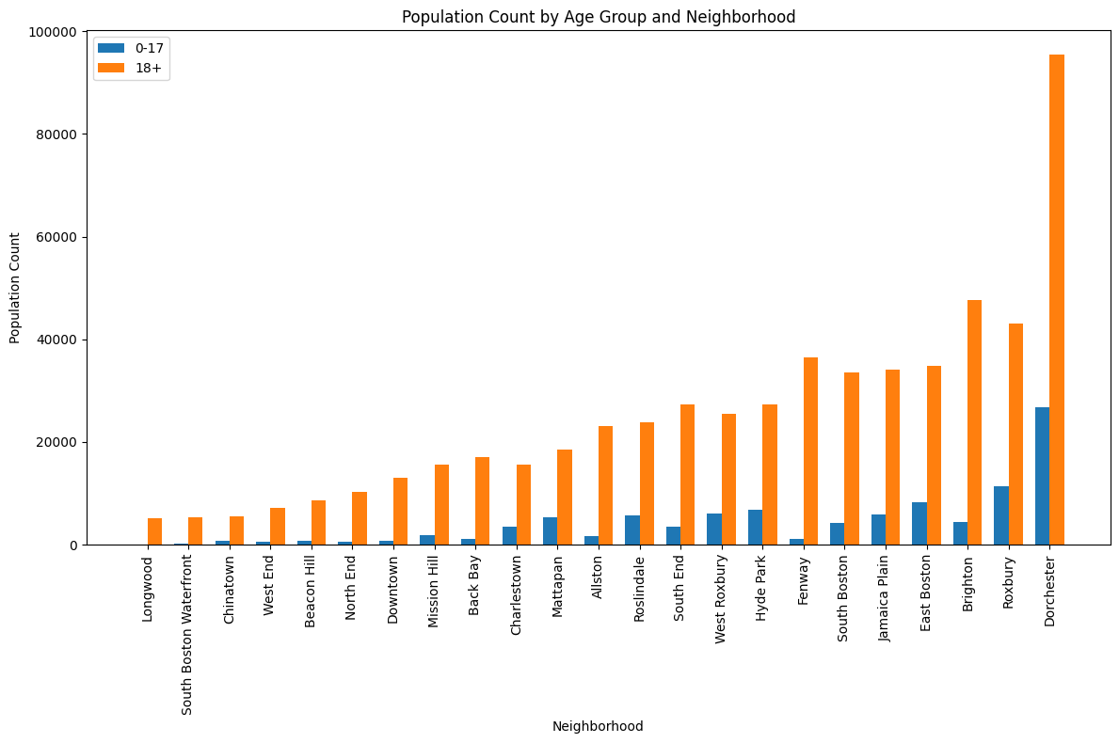
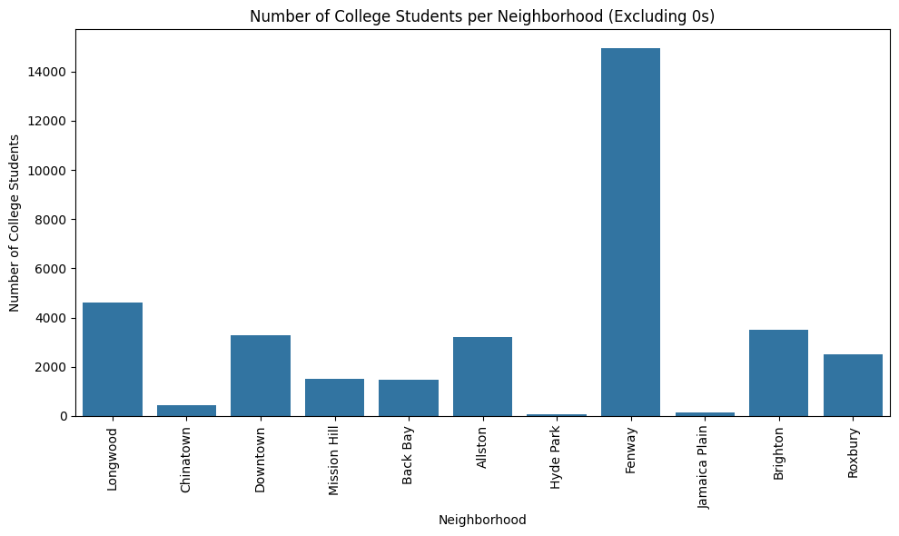
Extension Project - Visuals
Neighborhoods tend to have a disproportionately larger number of 18+ individuals and very small percentage who are 0-17 years old.
College students in each neighborhood of Boston with Fenway being a very popular location for students to live in.

Slide 8
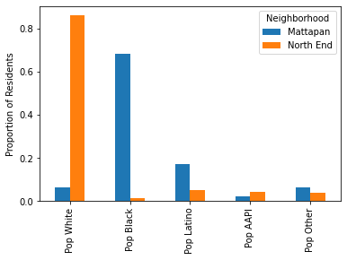
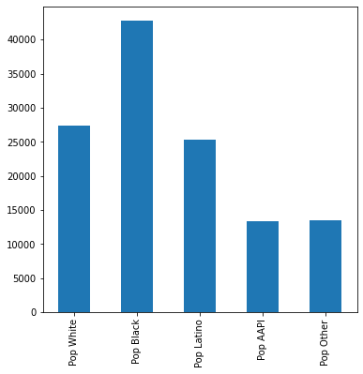
Extension Project - Visuals
Race demographic breakdown of Dorchester (largest neighborhood) which has 35% African American residents, 21% White and Hispanic and 11% Asian/Pacific Islanders and Other
Inverse relationship between African American and White populations in the neighborhoods with the largest and smallest proportions of African American residents

Slide 9
Challenges and Limitations
One limitation of the analysis provided is regarding the census data. The census is usually taken every 10 years so the last sample is from 2020
One challenge encountered was working with data from different sources that don't exactly line up
An additional limitation encountered was regarding the missing data in some of our data sources

Slide 10
Teammate Contributions
Toby: Toby performed the preliminary exploratory data analysis for the Extension Project dataset. He also cleaned and preprocessed the data before creating the data visualizations to draw insightful observations from. He also contributed to the slides information for Deliverable 3.
Lucy: Lucy performed the research tasks to gain the necessary background for the Extension Project. She tried to find additional datasets to add to the current one from 2020. Additionally, she contributed to the slides information for Deliverable 3.
Deep: Deep also worked on finding additional datasets for the Extension Project and began cleaning the new data set to perform preliminary data analysis and create new data visualization. He also helped to contribute to the slides for Deliverable 3.
Thian: Thian continued his work from Deliverable 2 and worked on all the slides with information from analysis of the Extension Project for the presentation for Deliverable 3. Thian also completed the scrum report for the week and met with the TPM this week to ensure the progress on the Extension Project was on the right track.

